Slide 1
Dijkstra’s Algorithm:
To calculate the shortest path using a MAZE
DIRECTED BY:
PROF.Henry Chang
DONE BY:
SAHITI EMANI
STUDENT ID:19556

Slide 2
TABLE OF CONTENTS:
INTRODUCTION
DESIGN AND PROCESS
IMPLEMENTATION
TESTING
CONCLUSION
BIBLIOGRAPHY

Slide 3
INTRODUCTION:
Dijkstra's Algorithm: The shortest path between two vertices is a path with the shortest length (least number of edges). Call this the link-distance.
Time Complexity of Dijkstra's Algorithm is
O(V2)
but with min-priority queue it drops down to
O(V+ElogV)
.Intuition behind Dijkstra’s Algorithm
The vertices in increasing order of their distance from the source vertex. Construct the shortest path tree edge by edge; at each step adding one new edge, corresponding to construction of shortest path to the current new vertex.

Slide 4
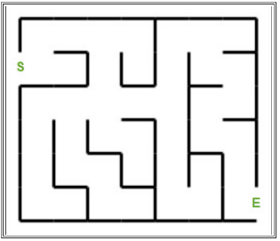
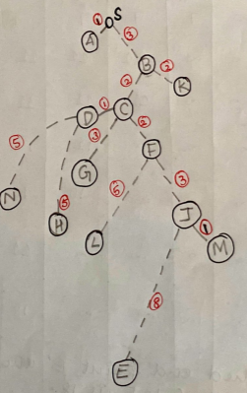
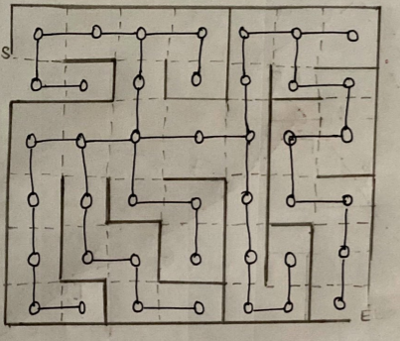
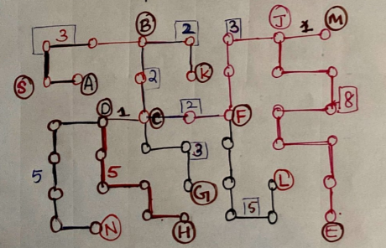
DESIGN AND PROCESS:
Use Dijkstra’s Algorithm to find the shortest path of the following maze:
STEP-1: Applying Dijkstra’s Algorithm to find the shortest path and join the dots and move forward accordingly,name the nodes for better understanding and draw the tree diagram .As shown below:
FIG:1 FIG:1.1 FIG:1.2 FIG:1.3
:

Slide 5
IMPLEMENTATION:
From,the maze diagram we can see two nodes that indicate S and E,they are indicated as the Start(“S”) and End(Destination”E”).One important rule to start the implementation of the djikstra’s Algorithm i.e,STARTING WITH S as”0” i.e considered to the INITIAL STEP to start the process and the other vertices are considered to start initially,with “INFINITY”.
Now, we start implementing the maze with required steps and find the minimum distance.

Slide 6
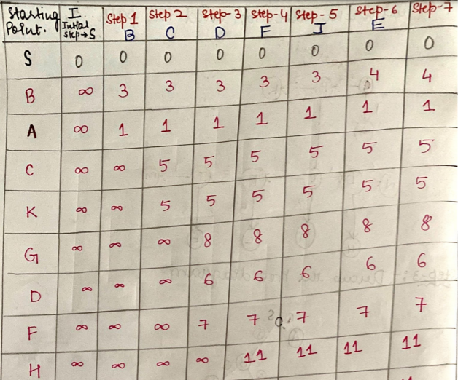
IMPLEMENTATION:Cont’d
Start with “S” and form it in a tabular form for better understanding and continue till you find the shortest distance until you reach the final destination “E” and we stop after that.

Slide 7
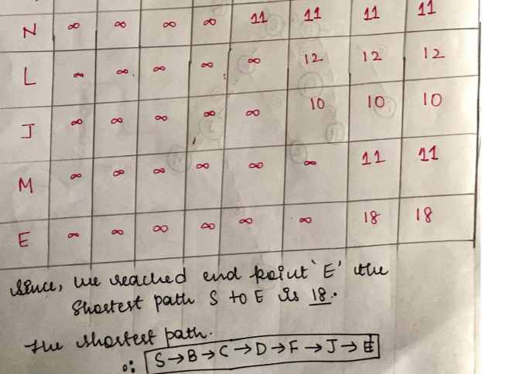
IMPLEMENTATION:Cont’d
Since,We continued the process until we reached “E”.Hence, we got the shortest path from S to E i.e:18.

Slide 8
TESTING:
Initial
S is smallest cost on Initial step.
Thus, S, is slected as the starting point for Step 1.
Step 1
S is selected as the starting point for Step 1.
From S₁, one can go to A₁ or B .
The accumulated cost on S₁ is not changed. It is still 0.
The accumulated cost on A is 1.
The accumulated cost on B is 2.
1 is smaller than 3.
Thus, A is selected as the starting point but there no following path from A so the values remain same and we will choose B for starting STEP 2.
Step 2
B is selected as the starting point for Step 2.
From B₃, one can go to C or K.
The accumulated cost on B is not changed from 3.
The accumulated cost on C is changed. It is till 5.
The accumulated cost on K is changed to 5 .
Comparing C,K have Same value.So,choose Cas no further path from K.
Thus, the next smallest number is picked, and C is selected as the starting point on Step 3.

Slide 9
TESTING:Cont’d
Step 3
C is selected as the starting point for Step 3.
From C, one can go to D,G or F.
The accumulated cost on B is not changed. It is still 5.
The accumulated cost on D is 6.
The accumulated cost on G is 8.
The accumulated cost on F is 7.
Comparing,6,7,8 value i.e 6 is smaller..
Thus, the next smallest number 6,is picked, and D is selected as the starting point on Step 4.
Step 4
C is selected as the starting point for Step 3.
From D, one can go to N or H.
The accumulated cost on D is not changed. It is still 6.
The accumulated cost on N is 11.
The accumulated cost on H is 11.
Comparing N,H have same value i.e 11.
Thus, the next smallest number is picked,but here the value is same and F is selected as the starting point on Step 5 because F is smaller than G..

Slide 10
TESTING:Cont’d
Step 5
F is selected as the starting point for Step 5.
From F, one can go to L AND J.
The accumulated cost on F is not changed. It is still 7.
The accumulated cost on L is 12.
The accumulated cost on J is 10.
Comparing,10,12 value i.e 10 is smaller..
Thus, the next smallest number 10,is picked, and J is selected as the starting point on Step 6.
Step 6
J is selected as the starting point for Step 6.
From J, one can go to M or E.
The accumulated cost on J is 10 as of now..
The accumulated cost on M is changed to 11.
The accumulated cost on E is changed to 18.
Comparing N,H have same value i.e 11.
Thus, the next smallest number is picked,but here the value is same and M is selected as the starting point on Step 7 because M is smaller than E..

Slide 11
TESTING:Cont’d
Step 7
M is selected as the starting point for Step 7.
From M, one can go to no further path is connected so the value remains same i.e 11..
Now,choose the nodes thar not visited during these steps.
The non-visited nodes are L and G.
The accumulated cost on L is 12.
The accumulated cost on G is 8.
Comparing L,G remains as 8 no more path from there after that we will go to L with the value as 12.
Hence, we reached the final destination i.e E.
Shortest Path is 18.
So,the direction of the shortest path is S-B-C-D-F-J-E.

Slide 12
CONCLUSION:
Dijkstra's Algorithm can only work with graphs that have positive weights, during the process, the weights of the edges have to be added to find the shortest path.
Dijkstra's algorithm is BFS with a priority queue.
But,its not applicable for negative weights.As an explanation i would like to mention in a form of an example,
It is difficult to comprehend if we consider an edge represents the distance between two cities. However, it makes sense if an edge represents the cost (negative number)or profit (positive number) for a business task.We can also use the edge to present the speed driving from one city to another one. Driving above an average speed is positive, below an average speed is negative.
Hence,we calculated the shortest path for the shortest path of the given maze i.e:with value as “S” to”E”==>18.
S==>B==>C==>D==>F==>J==>E

Slide 13
BIBLIOGRAPHY:
https://www.hackerearth.com/practice/algorithms/graphs/shortest-path-algorithms/tutorial/
https://npu85.npu.edu/~henry/npu/classes/algorithm/graph_alg/slide/exercise_graph_alg.html
https://www.geeksforgeeks.org/dijkstras-shortest-path-algorithm-greedy-algo-7/

